Slide 1
Development of Floor Level Material Transfer Mobile Robot
Batch No. MRP02
Project Members
Lalithesh K (RA2211038010007)
Tejas M K (RA2211038010012)
Preetham M (RA2211038010046)
Under the Guidance of
Dr. R. Senthilnathan M.E., Ph.D.

Slide 2
Project Objective
The primary objective is to develop an autonomous indoor delivery robot capable of transporting materials between designated locations (Entrances of various rooms) within a single floor of a building (Hi-tech 2nd Floor).
The various tasks to accomplish the objective are:
  To implement mapping and localization using onboard sensors, enabling the robot to autonomously navigate and plan optimal paths within its environment.
  To enable safe and reliable navigation and path planning, ensuring the robot can operate in dynamic environments and maintain a safe coexistence with human activity.
  To develop a user-friendly interface for assigning pickup and drop-off tasks, providing intuitive interaction and real-time status monitoring.
The secondary objectives are:
  To integrate an autonomous docking mechanism that allows the robot to return to a charging station and recharge automatically when the battery level is low.
  To design and implement a developer dashboard that provides remote monitoring, manual pilot control, and system diagnostics for maintenance and performance evaluation.
21MHP401L/403L - Major Project

Slide 3
High Level System Block Diagram
Charge Monitoring and Docking
Override delivery tasks if charge low
Mapping & Localisation Module
User Interface
Mission/Task Manager
Perception Module
Pickup & Dropoff
Arrival for Pickup or Dropoff
Global Planner
Obstacle Detection Module
Map
Alerts & Notification System
Dynamic Obstacle in Path
Control Module
Local Planner

Slide 4
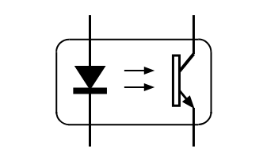
Hardware Block Diagram
IMU
(Inbuilt with ZED Camera)
Slip Compensation
5V
USB
Wi-Fi Module
ZED Mini Stereo Camera
12V
UART
Primary Perception
Jetson Nano
Motor Driver
Digital
LIDAR
Direction
Proximity Detection
Speed
PWM
Cliff Detection
Motor Encoders
Motor
Analog
Ultrasonic Sensor
Mechanical Coupling
Sensor
Adapter
DC to AC Converter
Power System
Charge State
Power Distribution Board
Discharge State
Actuation System
Charging Module
Charging
Battery
Communication System

Slide 5
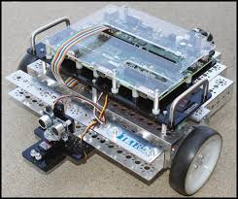
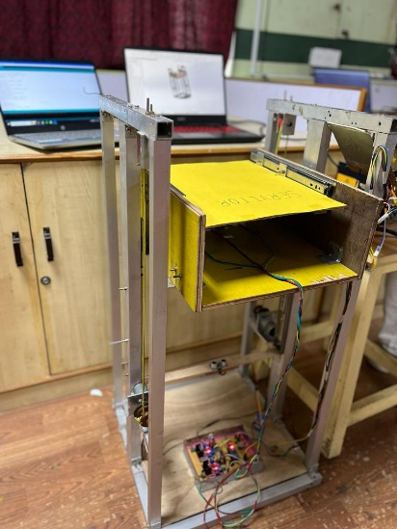
Methodology
System Architecture and Environment Setup
Structural Modifications and Charging Equipment
Mapping and Localization
Navigation and Task Handling
User Interface Development & Integration
Testing and Validation
21MHP401L/403L - Major Project

Slide 6
Context & Motivation
Name | Context | Motivation
Operational Scope | The robot operates only within a single floor (only room entrances), as it lacks stair-climbing or elevator integration capabilities. | To ensure reliable navigation and path planning within a controlled environment minimizing complexity in the initial implementation.
Environmental Factors | Designed for indoor environments with flat floors with adequate lighting and Wi-Fi coverage. | Flat, even surfaces minimize odometry drift and prevent sensor misalignment, ensuring consistent motion tracking and obstacle detection. Adequate lighting supports stereo vision accuracy, while stable Wi-Fi ensures reliable task communication.
Payload Considerations | Limited to lightweight materials and equipment. | To maintain mechanical stability and power efficiency while ensuring the drive system can achieve precise movement and stopping without overloading.
Power and Energy Management | The robot operates on an onboard battery system, with runtime limited by its energy capacity. | To maintain complete mobility and independence from fixed power sources, allowing the robot to operate freely within the floor without external power connections.
Safety and Human Interaction | The robot employs a stall-and-alert approach for handling dynamic obstacles and alerts nearby individuals to clear the path while avoiding static obstacles to reduce algorithmic complexity and avoid multiple case issues. | To balance safety and efficiency by focusing on predictable navigation behaviour that minimizes computational load and avoids unpredictable re-planning near humans.
21MHP401L/403L - Major Project

Slide 7
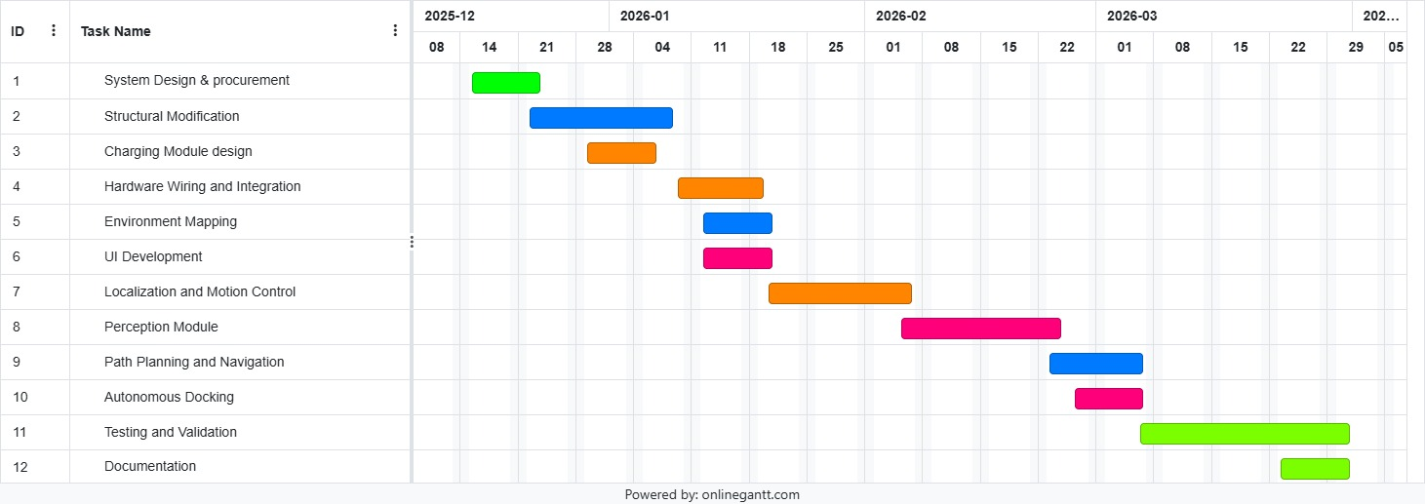
Timeline
Real-world Testing
Documentation & Reporting
All
Lalithesh
Tejas
Preetham
21MHP401L/403L - Major Project

Slide 8
Subtasks in Modules
Modules | Tasks
System Design & Procurement | System Workflow & Behavioural Flowchart, Review of System Workflow and Behavioural Flowchart, Setup Development Environment, Procure Components
Structural Modification | Chassis height increase and casing design, Increase Chassis Height and Fabricate Case
Charging Module Design | Design & Integration of Charging module
Hardware Wiring & Integration | Hardware placement & wiring, Integration & Interfacing of Hardware Components, Testing & Validation of Hardware, Integrate Speaker for Voice Alerts
Environment Mapping | Setup Environment to Build Map (Aruco Tags), Develop approach to build & store map using depth information from ZED Camera
UI Development | Developer UI(Joystick for piloting), Integrate Joystick UI with Jetson and Motors for Piloting, Integrate Odometry and IMU based Localization in Developer UI, Display Stored Map on Developer UI, Get Pickup & Dropoff Points, Multi –User Login and Task Management, Development & Integration of User UI
Localization & Motion Control | Encoder feedback and Odometry, Integrate IMU for Slip Compensation, Testing and Validation of Localization based on Odometry and IMU data, PID Tuning of Motors for speed control, Implement drive kinematics, Integrate Aruco based localization
Perception Module | Integrate ARUCO Based Labelling, Cliff & Proximity Detection, Obstacle Detection
Path Planning and Navigation | Global Planning Algorithm, Local Planning, Task Scheduling Algorithm, Integration & Testing of Navigation Stack
Autonomous Docking | Autonomous Docking & Charging Station Setup
Real-World Testing | Perform Real-World Delivery trials & Fixing issues
Documentation & Reporting | Code Documentation, Hardware Documentation, Report Preparation

Slide 9
Work Split-up
Member | Modules
Lalithesh K | Charging Module Design Hardware Wiring and Integration Localization and Motion Control
Tejas M K | UI Development Perception Module Autonomous Docking
Preetham M | Structural Modification Environment Mapping Path Planning and Navigation
All | System design and procurement Real world testing and validation Documentation and reporting
21MHP401L/403L - Major Project

Slide 10
Key Deliverables
Validated Core Platform: A functional indoor delivery system establishing the baseline architecture for autonomous logistics in structured environments. The robot is designed as a department-level asset.
Scalable Software Framework: Modular ROS-based architecture that can be extended to various floors, and cross-domain applications such as hospitals or offices.
Autonomous Charging Integration: Implementation of a self-directed docking and plug-in charging system, allowing the robot to independently navigate to a charging station and restore power without human intervention.
Human-Aware Navigation: Navigation stack refined for safe coexistence with human movement, paving the way for more adaptive, context-aware robotic behaviour.
Developer Dashboard and Maintenance Tools: A dedicated dashboard providing remote monitoring, manual pilot control, map updates, and troubleshooting capabilities. This interface allows developers to perform diagnostics, system calibration, and environment remapping efficiently.
Research and Analytical Outcomes: Insights into real-world accuracy, path optimization under dynamic conditions, and system-level trade-offs between autonomy and safety.
Foundation for Future Development: A validated base for extending to various floors for autonomous delivery in large indoor environments.

Slide 11
Thank You

